Slide 1
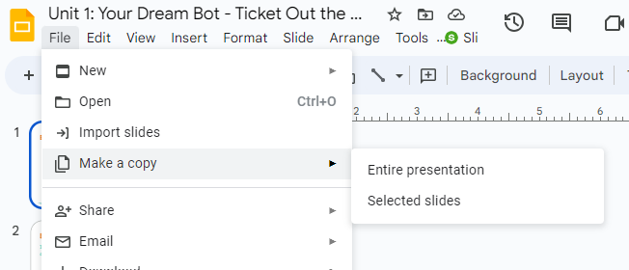
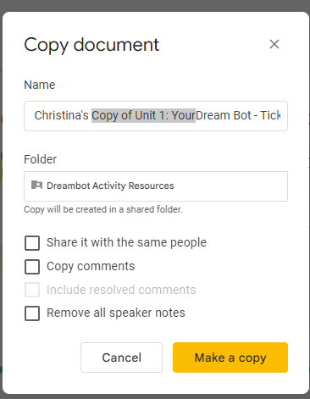
Before Editing Make a copy of this document
STEP 2
Add your name
Delete highlighted text
STEP 1: File > Make a copy > Entire Presentation
Step 3 - Click Make a copy

Slide 2

My Dream Bot
Create your own dream robot using your robot expertise!
Developed for the AI4GA (Artificial Intelligence for Georgia) project funded by National Science Foundation awards DRL-2049029 and DRL-2048502.
Additional funding was provided by a gift from Google. This work is licensed under the Creative Commons Attribution-NonCommercial-ShareAlike 4.0 International License. https://creativecommons.org/licenses/by-nc-sa/4.0/
Notes:
This is a 2-3 day project depending on how how students model their robot (tinkerCAD, poster, etc).

Slide 3
Project Expectations
As you design your robot, you will:
Identify at least three (3) physical characteristics
Identify at least three (3) decisions your robot will make about how to accomplish its task
Choose at least three (3) sensors
Explain why your robot needs EACH sensor
Identify the need for Route Finding
Illustrate an example route your robot might travel
Identify the potential societal impact of your robot

Slide 4

Enter Robot’s Name Here
_________________
My Robot Can
__________________
Notes:
What is the general purpose of your robot? Fill that into “My robot can…”

Slide 5
Physical Characteristics
My robot looks like:
Describe your robot
…
…
…

Slide 6
Decisions
Let’s make your dream robot autonomous!
What decisions will your robot make in order to accomplish its tasks?
…
…
…

Slide 7
Sensors
 | Type | Purpose (Why will your robot need each sensor?)
Sensor 1
Sensor 2
Sensor 3

Slide 8
Route Finding
What environment does your robot work in?

Slide 9
Route Finding
Illustrate an example route your robot might travel

Slide 10
Possible Societal Impact
Describe the impact your robot has on society (in 4 complete sentences)
Negative
1 …
2 …
Positive
1…
2…

Slide 11
Create Your Robot
Options to Create your robot:
A labeled drawing (Hand Drawn Poster, Google Drawing, AI Generated)
A description and diagram
3D model: https://www.tinkercad.com/learn
Cardboard model
Legos to build 3D physical model

Slide 12
Project Checklist
As you design your robot, you will:
Identify at least three (3) physical characteristics
Identify at least three (3) decisions your robot will make
Choose at least three (3) sensors
Explain the benefits of EACH sensor
Identify the need for Route Finding
Illustrate an example route your robot might travel
Identify the potential societal impact of your robot

